Slide 1
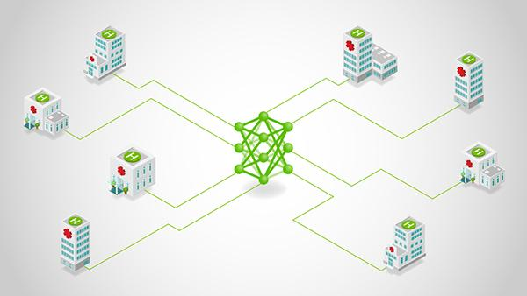
Multi-Task Federated Learning for Personalized Deep Neural Networks
TEAM -6
DEEPTI SINHA
MADHURA KADABA
PRAJNA K
SARTHAK SHARMA
SUBIN PILLAI
IISc FACULTY
PROF. CHANDRAMANI SINGH

Slide 2
Multi-Task Federated Learning (MTFL)
Multi-task Federated Learning (MTFL) is an extension of Federated Learning (FL) that focuses on training multiple related models across distributed devices rather than a single global model, without sharing any raw data.
KEY DIFFERENCES:-
Feature | Federated Learning (FL) | Multi-task Federated Learning** (MTFL)
Model type | Single Global Model | Multiple Personalized Models
Data distribution | Assumed similar data across all clients | Handles heterogenous data across clients (non–IID different but related datasets)
Optimization strategy | Federated Averaging (FedAvg) | Multi-task optimization (FedAvg-Adam**)
Accuracy metric | Global model accuracy | User model accuracy (UA **)
Use case | Common tasks across all clients | Personalized learning for all clients
Computation | Takes place centrally on the server | Off-loaded to client devices
https://arxiv.org/pdf/2007.09236 **proposed in this paper by Jed Mills, Jia Hu, Geyong Min

Slide 3
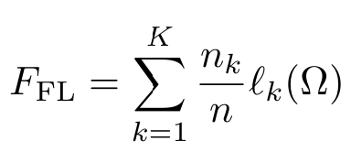
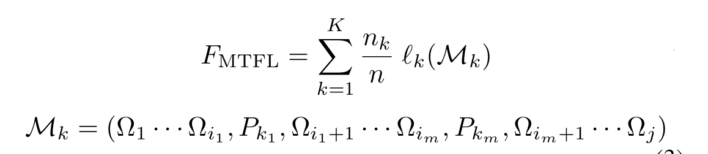
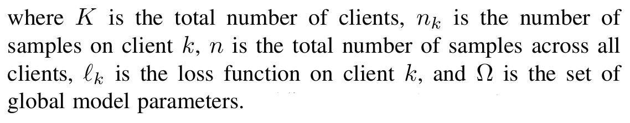
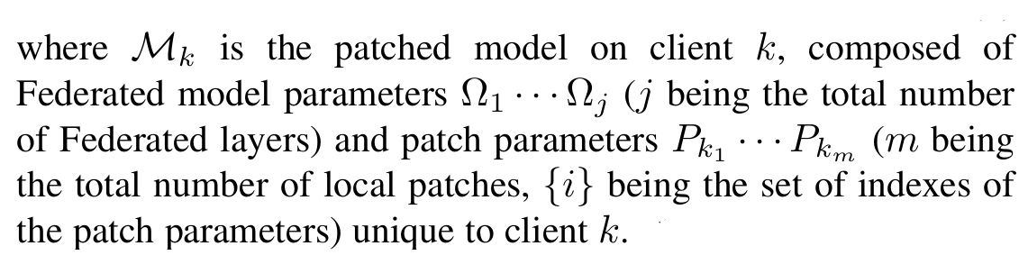
Multi-Task Federated Learning (MTFL)
Feature | Federated Learning (FL) | Multi-task Federated Learning** (MTFL)
Loss function
https://arxiv.org/pdf/2007.09236 **proposed in this paper by Jed Mills, Jia Hu, Geyong Min

Slide 4
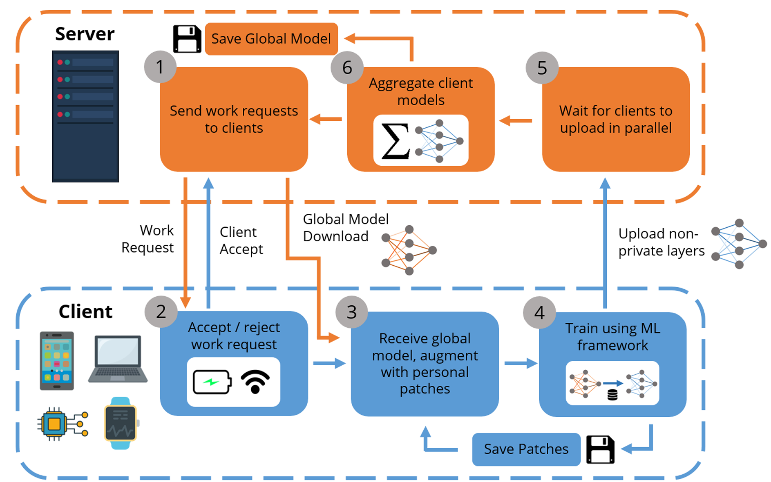
MTFL ALGORITHM
MULTI-TASK FEDERATED LEARNING
Step 1: The server selects a subset of clients from its database to participate in the round, and sends a work request to them.
Step 2: Clients reply with an accept message depending on physical state and local preferences.
Step 3: Clients download the global model (and any optimization parameters) from the server, and update their copy of the global model with private Batch Norm layers as patches.
Step 4: Clients perform local training using their own data, creating a different model. Clients save the private patch layers (BN) locally, and upload their non private model parameters to the server.
Step 5: The server waits for C fraction of clients to upload their non-private model and optimizer values, or until a time limit.
Step 6: The server averages all models, saves the aggregate, and starts a new round.
REFERENCE: https://arxiv.org/pdf/2007.09236

Slide 5
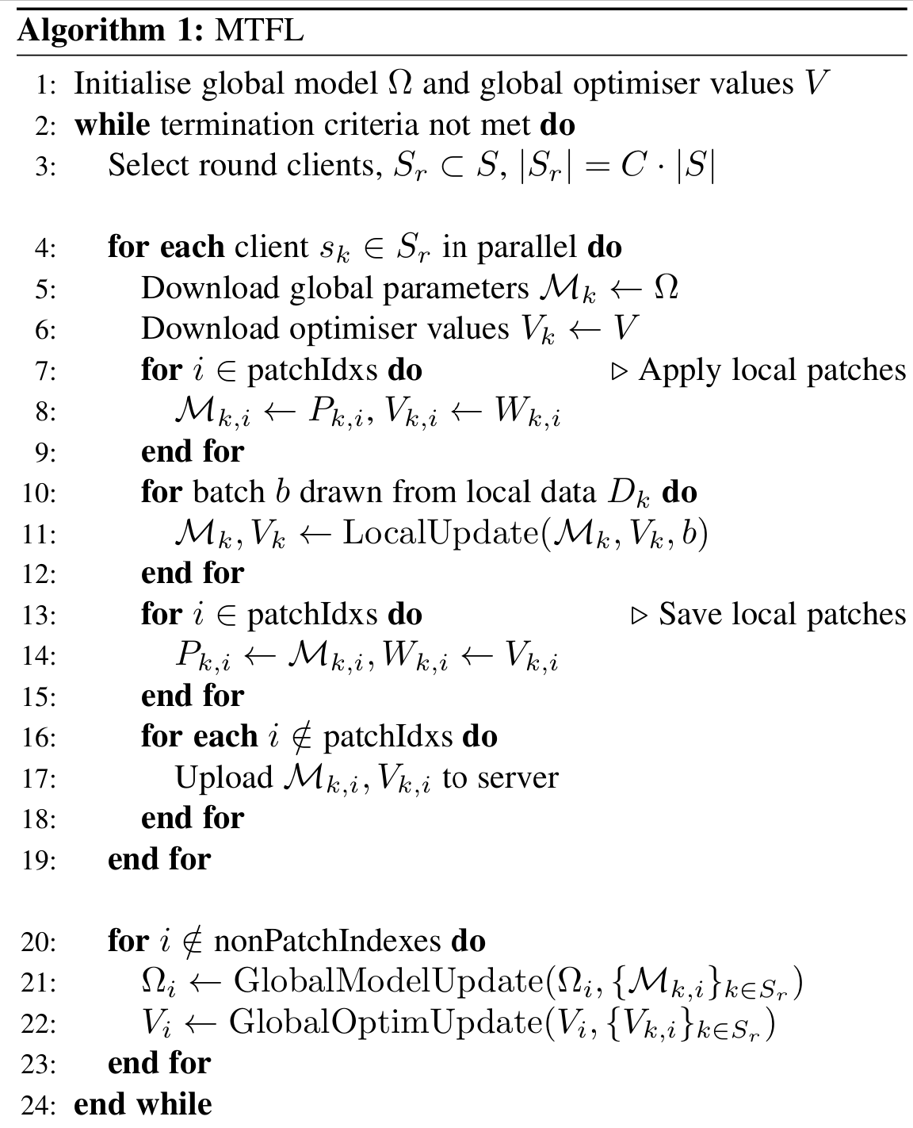

MTFL ALGORITHM
We simulated the federated learning process with Global Server + Multi-Client setup using the Flower framework.
Each sampled client trained locally on their own data.
METRICS : User model accuracy (UA), Number of communication rounds required to achieve benchmark user model accuracy.
STOPPING CRITERIA : Reach benchmark user model accuracy (UA = 97% for MNIST, UA = 65% for CIFAR10) or run for a fixed number of communication rounds (T).
We compared the performance with custom optimization strategy (FedAvg-Adam) and various existing strategies (FedAvg, FedAdam) with/without private BN params.
patchIdxs contain the indexes of the patch layer placement in the DNN
REFERENCE: https://arxiv.org/pdf/2007.09236

Slide 6
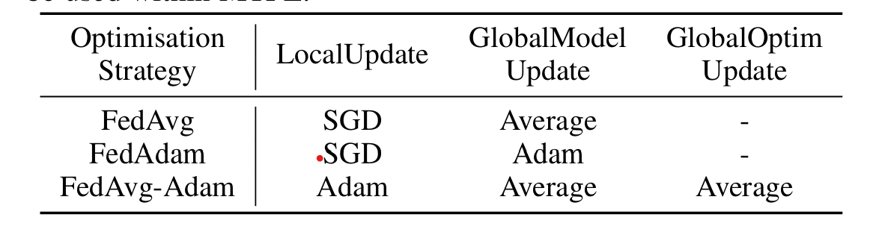
OPTIMIZATION STRATEGIES
FedAvg
FedAdam
FedAvg-Adam
LocalUpdate is minibatch-SGD.
GlobalModelUpdate produces the new global model as a weighted (by number of local samples) average of uploaded client models.
Clients do not use distributed adaptive optimization. (Optimizers V is empty).
GlobalOptimUpdate performs no function.
LocalUpdate is minibatch-SGD.
GlobalModelUpdate, the server takes the difference (∆r) between the previous global model and the average uploaded client model to update the global model using an Adam-like update step.
Clients do not use distributed adaptive optimization. (Optimizers V is empty).
GlobalOptimUpdate performs no function.
All clients share a global set of Adam optimizer values (Optimizers V) received from server.
During LocalUpdate, clients perform Adam SGD, and the federated model layers and new Adam values are uploaded by clients at the end of the round.
To produce a new global model, the server averages the client models in GlobalModelUpdate and averages the Adam moments in GlobalOptimUpdate.
Benefits: Improved convergence speed.
Downside: Increased communication cost per round.

Slide 7


DATASET & FRAMEWORKS USED
Datasets:
 | MNIST | CIFAR10
Data Size | 70,000 labelled images (60k train + 10k test) | 60,000 labelled images (50k train + 10k test)
Image size | 28x28x1 (Gray-scale) | 32x32x3 (RGB image)
Classes | 10 (handwritten digits) | 10 (birds, animals, automobiles)
Transforms | Normalize, Convert to tensor | Normalize, Convert to tensor
Flower

Slide 8
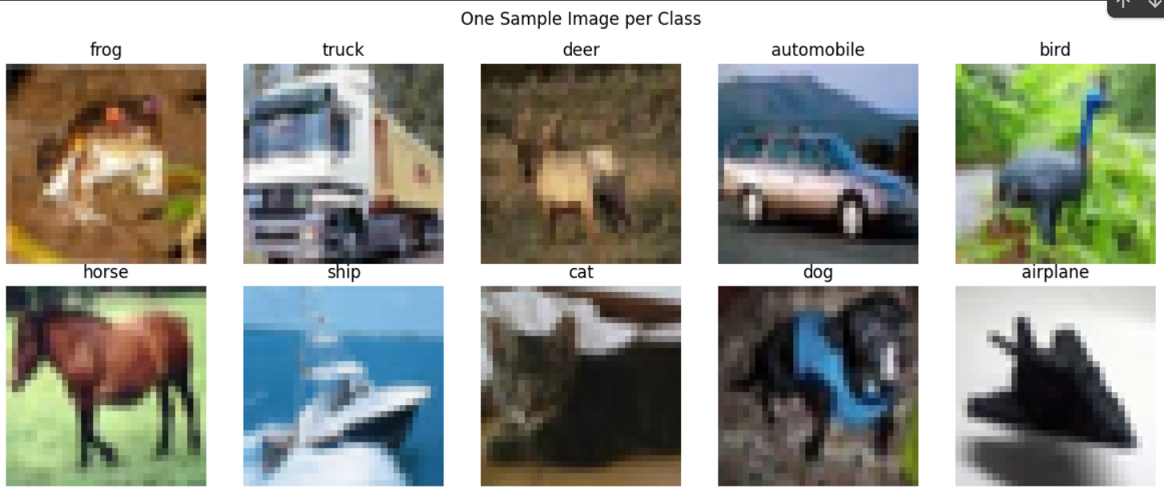
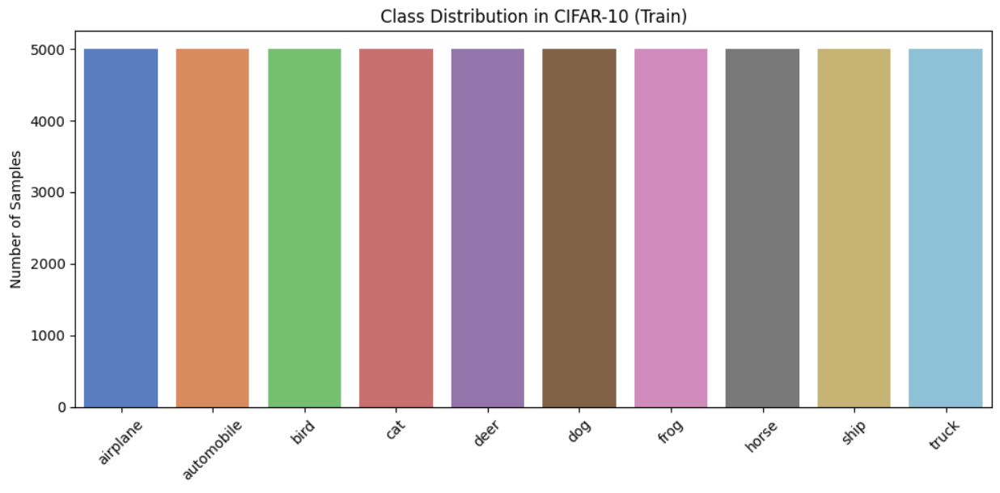
Data distribution and example for CIFAR-10

Slide 9
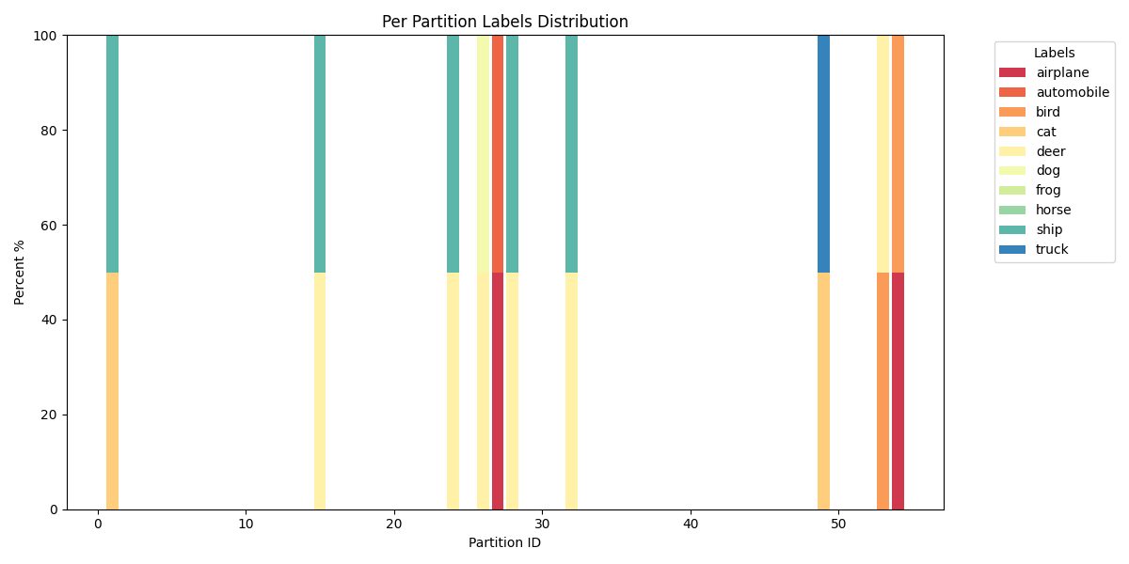
DATA PRE-PROCESSING
Creating non-IID data-set partitions across clients:
We created a custom function to generate the non-IID partitions, aligned with the strategy described in the paper.
First, we order the training and testing dataset by label and then perform the non-IID split.
Each client has the same classes within their respective training and testing datasets
Number of clients = W
Number of shards = 2xW
Shards per client = 2
Data distribution for 10 random clients post non-IID data-set partition for CIFAR-10

Slide 10
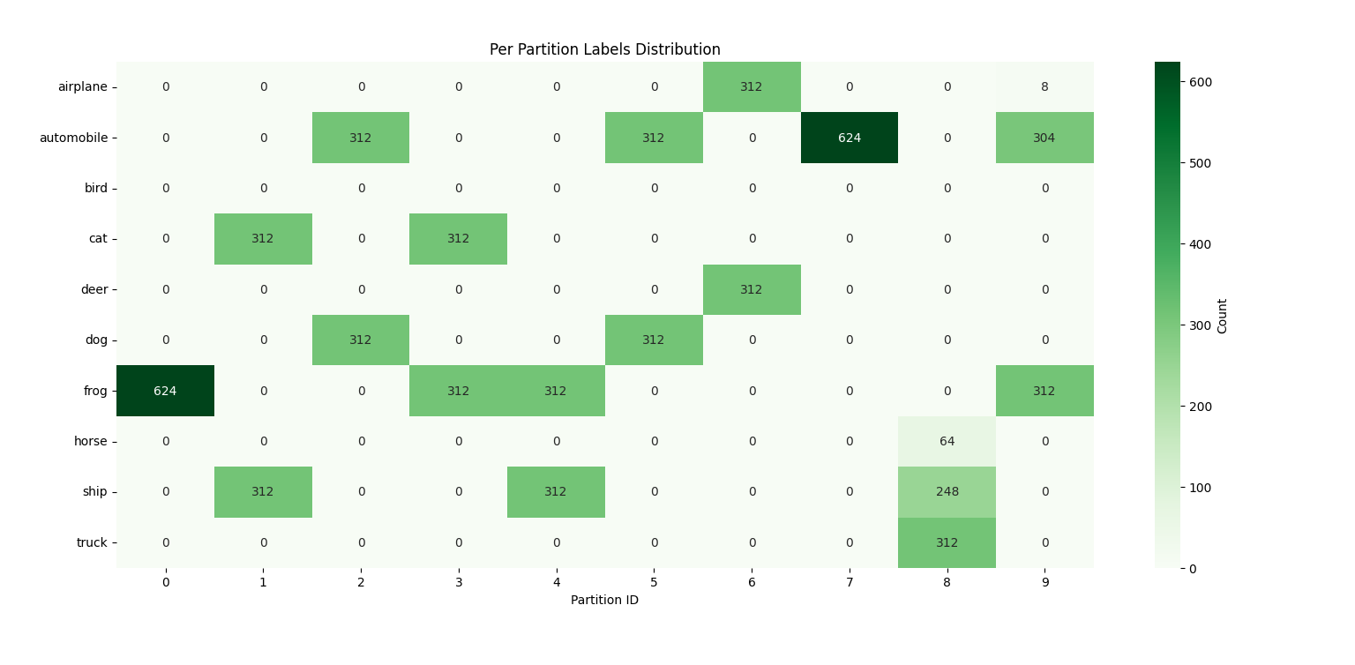

Slide 11
MODEL DETAILS (DNN with private BN)
28 x28 Grey Scale image (MNIST) serialized as 784x1
32 x32x3 RGB image (CIFAR10)
Conv layer: Input channels: 3, output channels: 32,Filter: 3
Linear Fully-connected layer
(Input dims:784, Output dims: 200)
ReLu activation
Max Pool 2x2
ReLu activation
Batch Normalization layer (dim: 32)
Batch Normalization layer
(dim: 200)
Conv layer: Input channels: 32, output channels: 64,Filter:3
ReLu activation
Linear Fully-connected layer
(Input dims:200, Output dims: 200)
Max Pool 2x2
Batch Normalization layer (dim: 64)
ReLu activation
Flatten (dim: 6x6x64)
Linear Fully-connected layer
(Input dims:200, Output dims: 10)
Linear Fully-connected layer
(Input dims:2304, Output dims: 512)
10x1 output array
ReLu activation
Linear Fully-connected layer
(Input dims:512, Output dims: 10)
10x1 output array

Slide 12
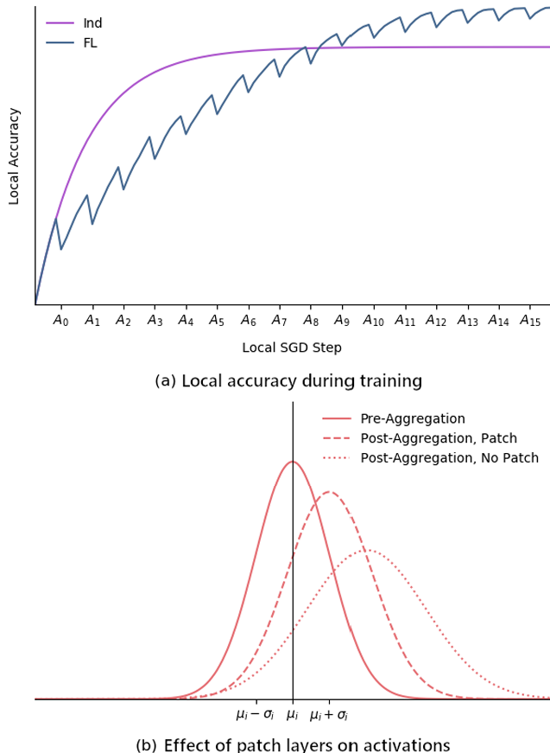
PRIVATE BATCH NORM LAYERS (PATCHES)
Batch Normalization (BN) layers normalize the activations of a neural network within each mini-batch to stabilize and accelerate training by reducing internal covariate shift.
Private BN layers allow local adaptation to non-IID data
Adding BN throughout the network acts as regularization → local outputs remain closer to their own distribution
Noisy clients can’t “pollute” the global model as easily because BN updates stay local

Slide 13
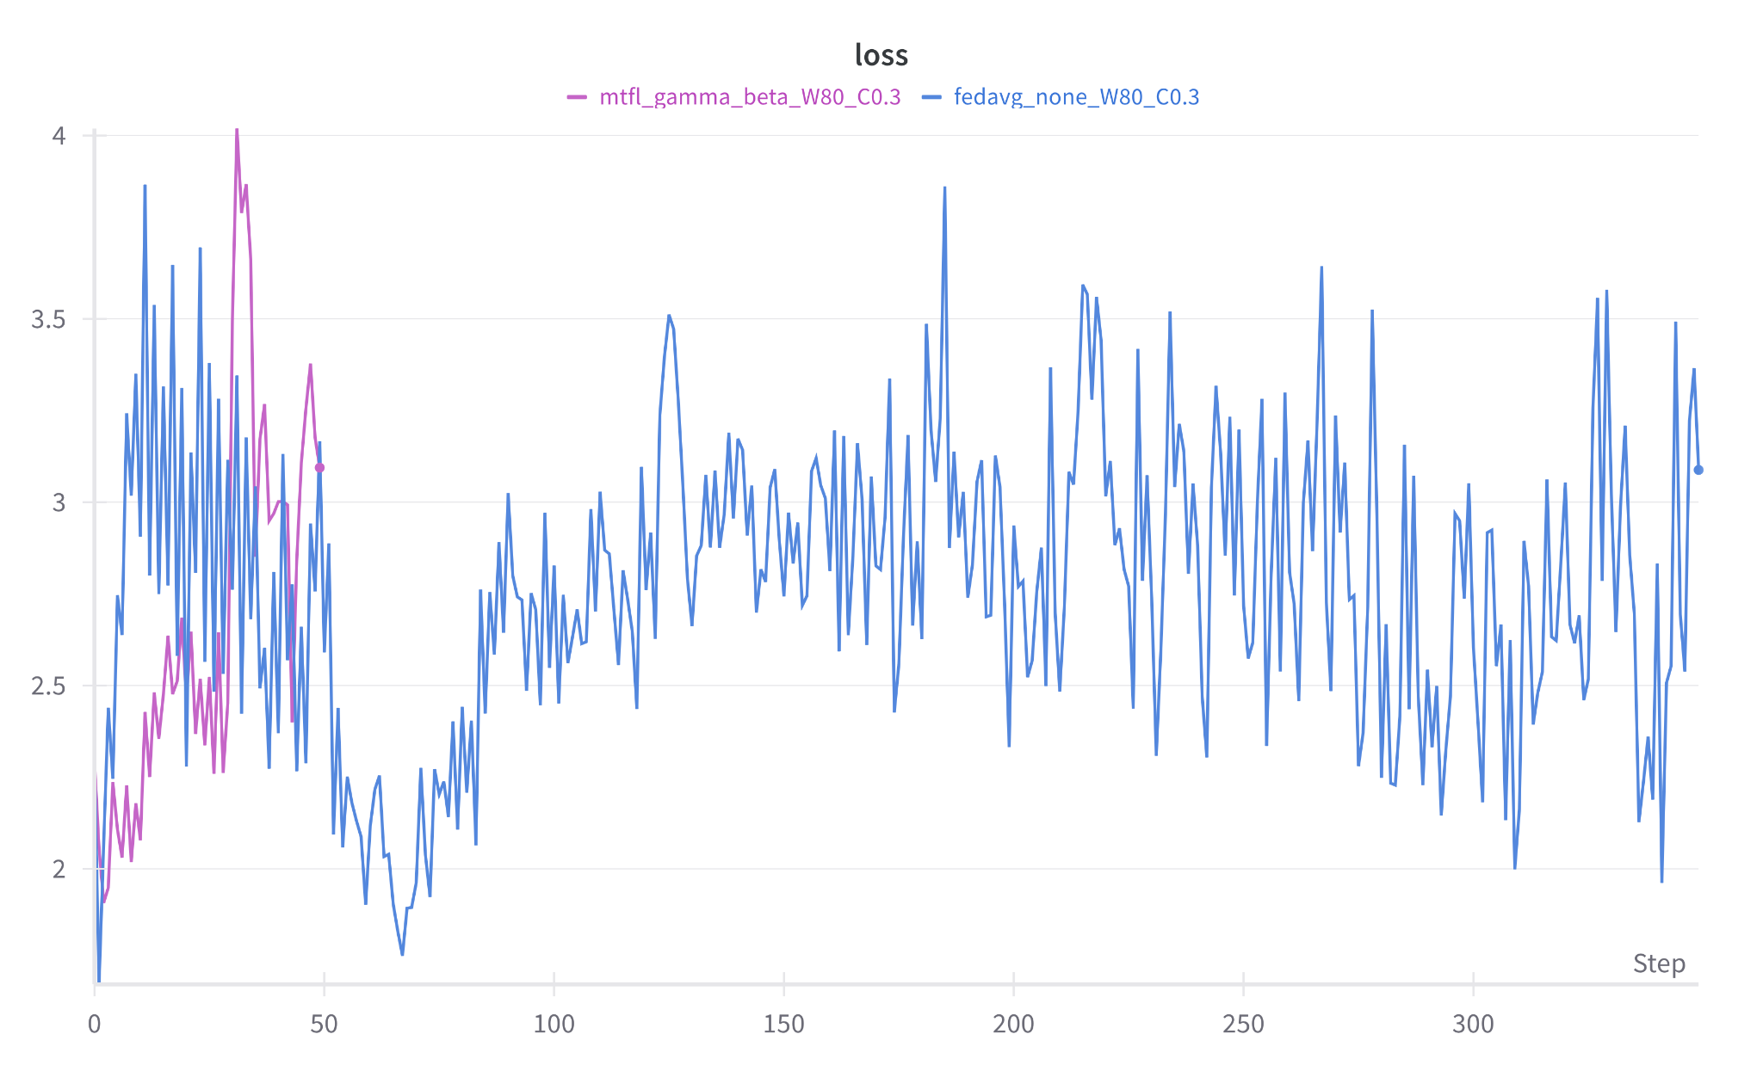
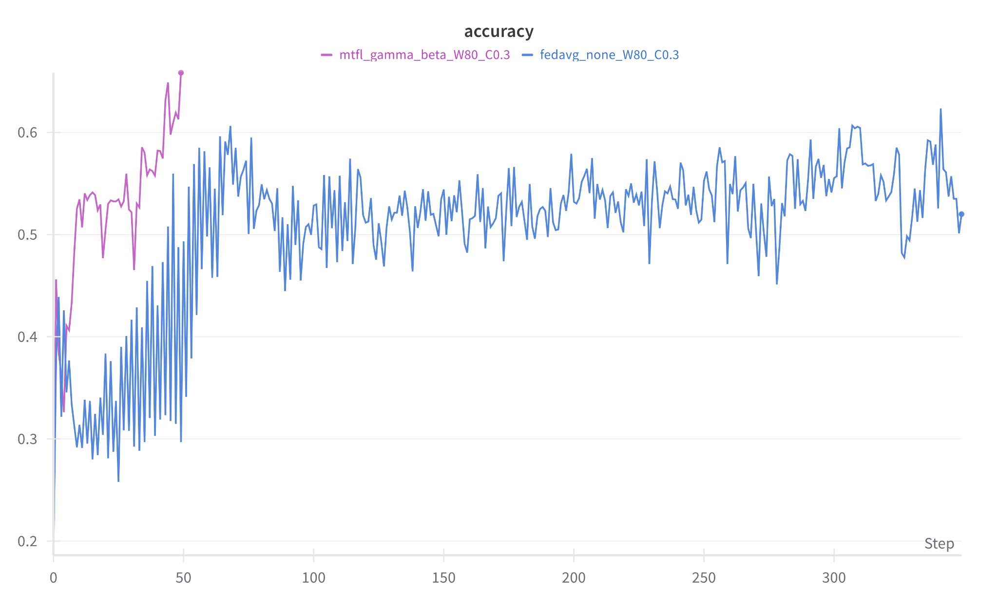
EXPERIMENTS & OBSERVATIONS - (1)
Comparing Loss and User Accuracy for FL-FedAvg vs MTFL-FedAvg-Adam (private gamma and beta) using CIFAR10 data

Slide 14
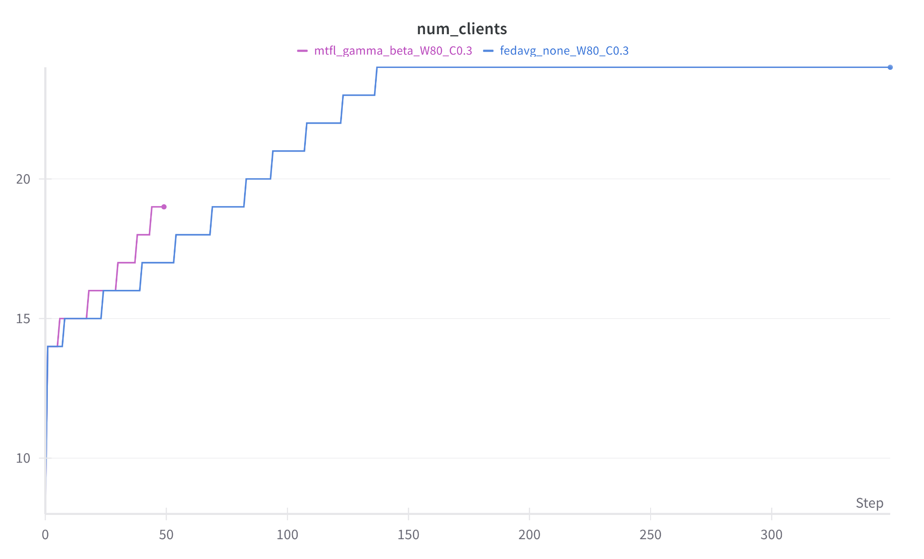
EXPERIMENTS & OBSERVATIONS - (2)
Caveat: Target accuracy for experiment was reached for MTFL-FedAvg-Adam before C (fraction of clients) was connected for training

Slide 15
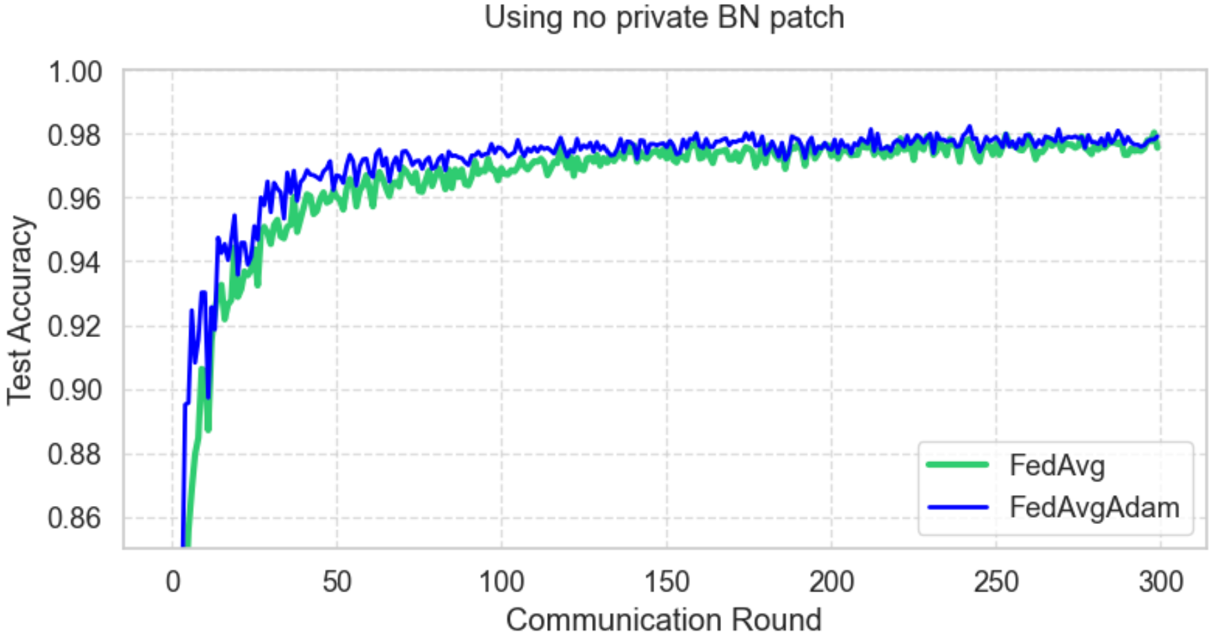
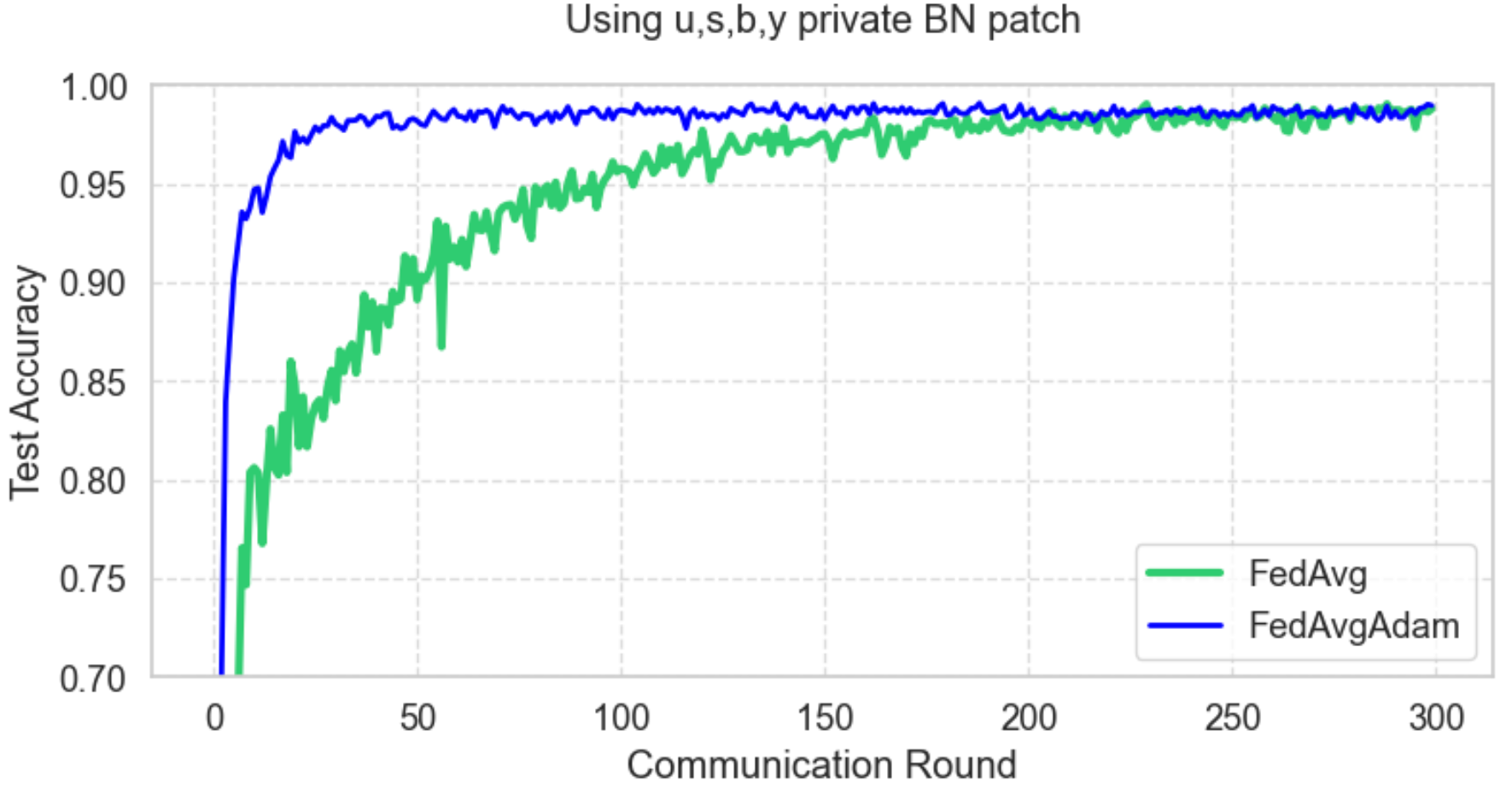
EXPERIMENTS & OBSERVATIONS - (3)
Comparing Test Accuracy for
FL- FedAvg/FedAvg-Adam vs MTFL- FedAvg/FedAvg-Adam using MNIST data
Clients = 200, Rounds = 300, Sample = 0.5
FL (No private parameters)
MTFL (u, s, y, b private BN parameters)
Convergence is faster with FedAvg-Adam algorithm when compared with FedAvg.
No. of rounds needed to reach 97% benchmark accuracy is much lower for case 2 than case 1

Slide 16
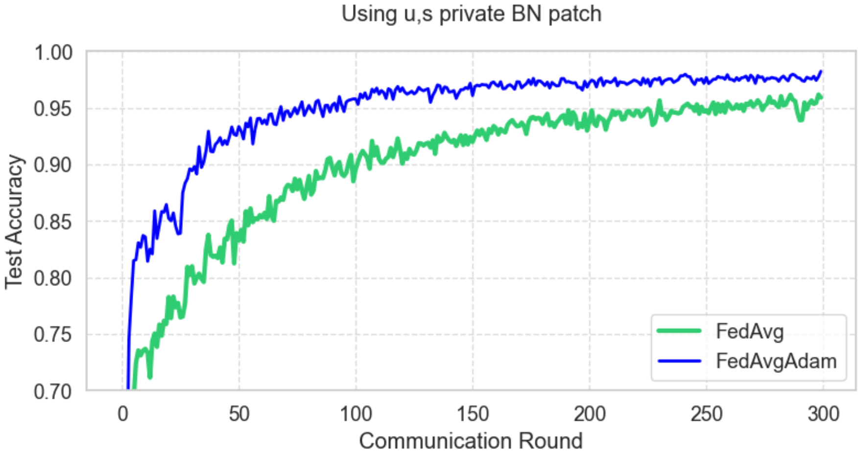
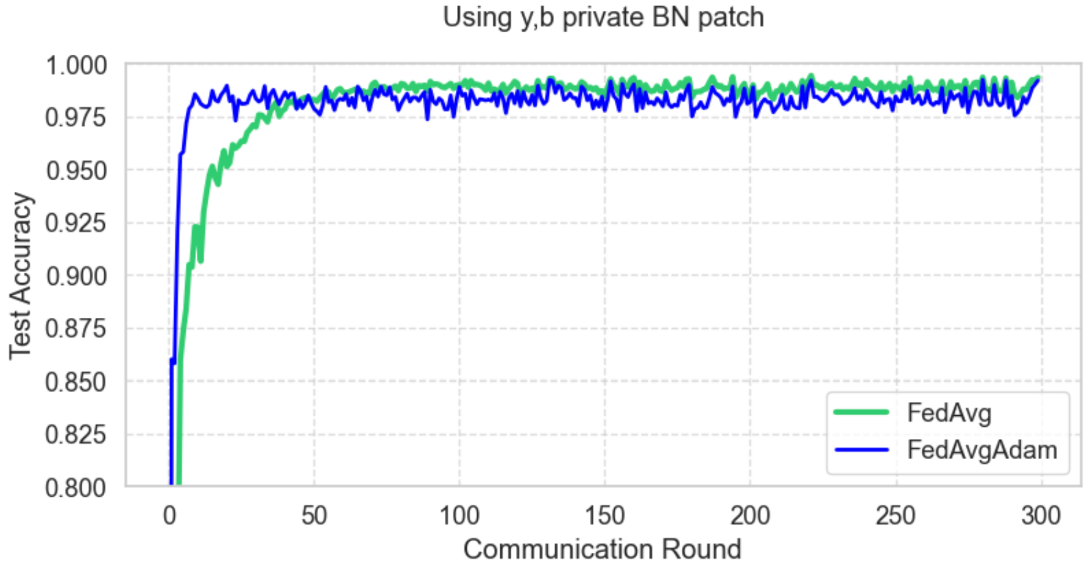
EXPERIMENTS & OBSERVATIONS -(4)
Comparing Test Accuracy for
FL- FedAvg/FedAvg-Adam vs MTFL- FedAvg/FedAvg-Adam using MNIST data
Clients = 200, Rounds = 300, Sample = 0.5
MTFL (u,s private BN parameters)
MTFL (y,b private BN parameters)
Convergence is faster with FedAvg-Adam algorithm when compared with FedAvg.
No. of rounds needed to reach 97% benchmark accuracy is much higher in case 1 than case 2

Slide 17
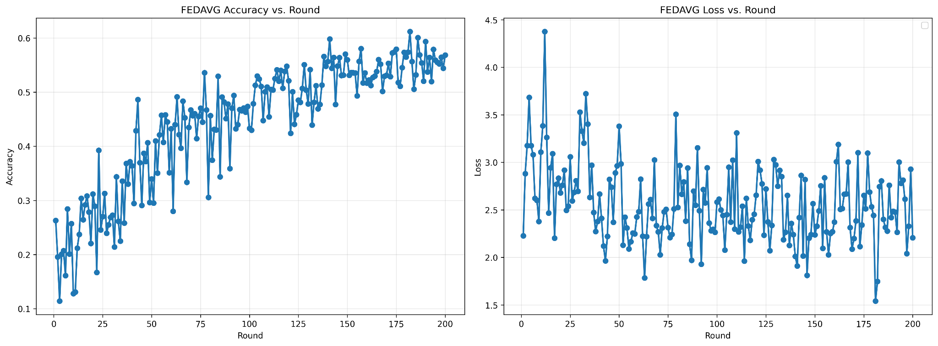
RESULTS AND DISCUSSIONS
Variation in the per-round testing User accuracy and loss in the FL-FedAvg approach

Slide 18
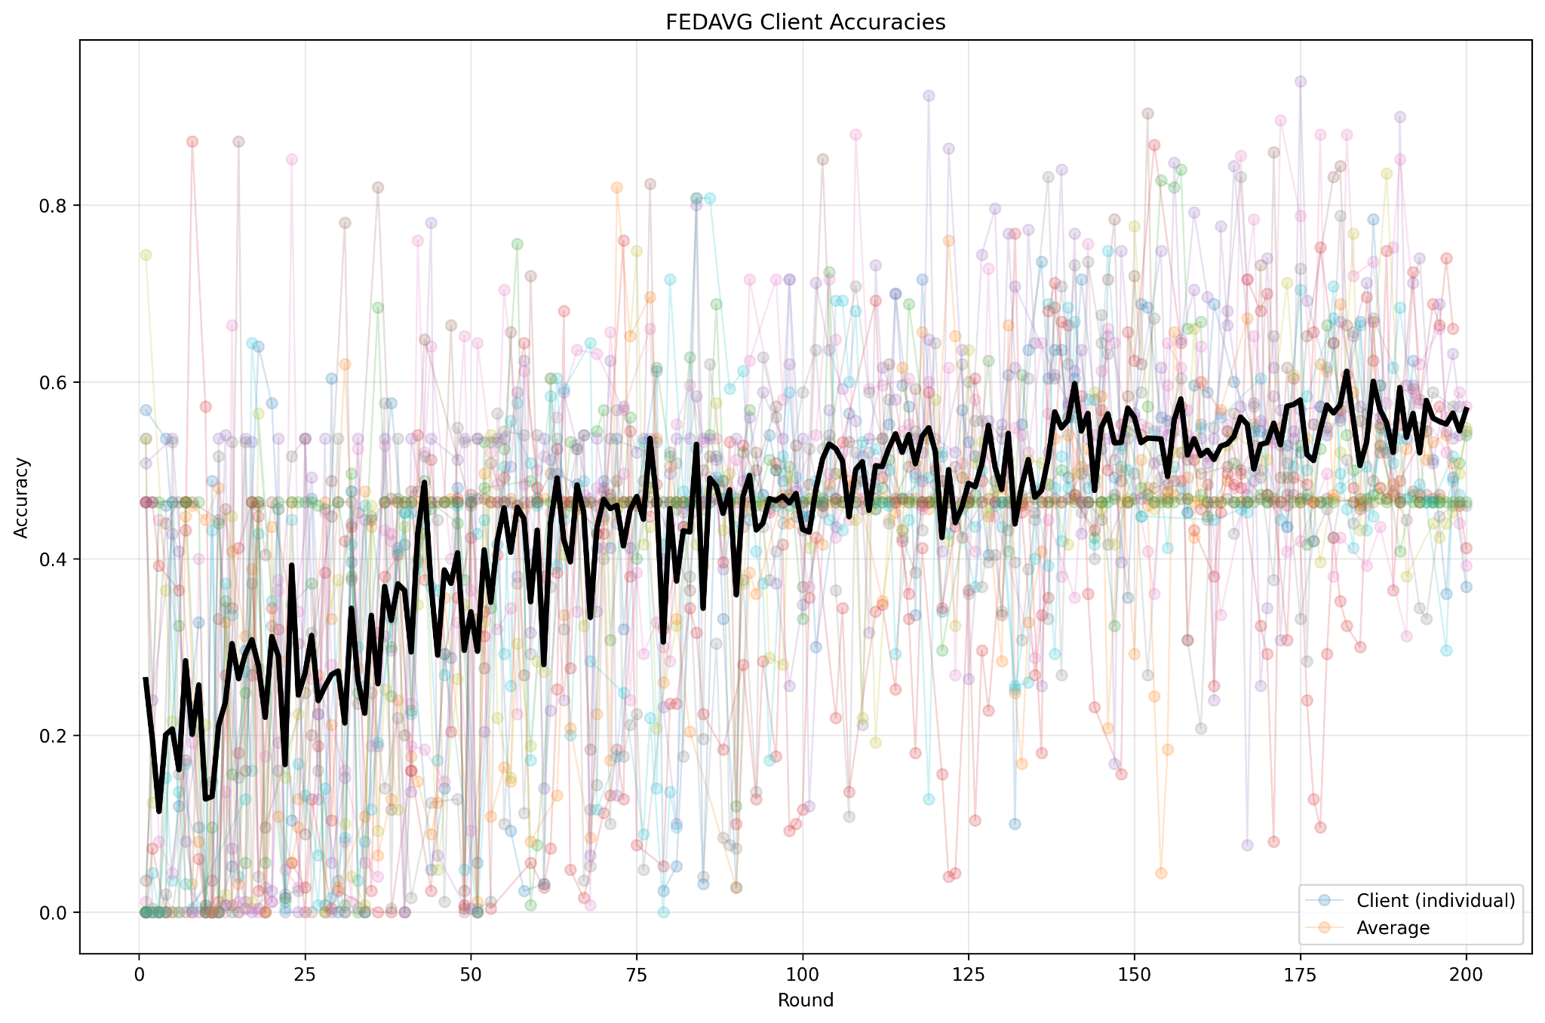
Variation in the per-round testing User Accuracy in the FL-FedAvg approach
Evidence of catastrophic forgetting in FedAvg
FedAvg has oscillations and slower convergence, affected by client drift
FedAvg loss hovers inconsistently between 2.0–3.5, showing instability in optimization

Slide 19
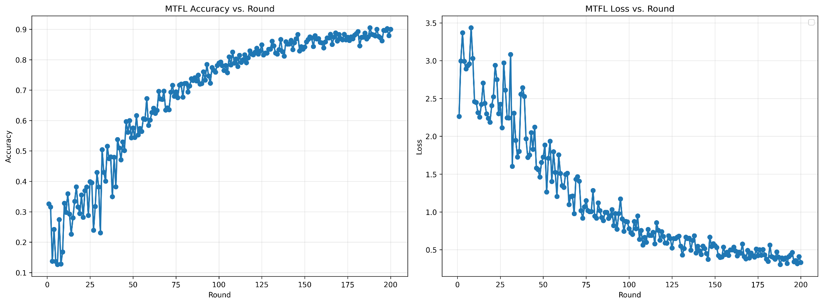
RESULTS AND DISCUSSIONS
Variation in the per-round testing User accuracy and loss in the MTFL-FedAvg approach

Slide 20
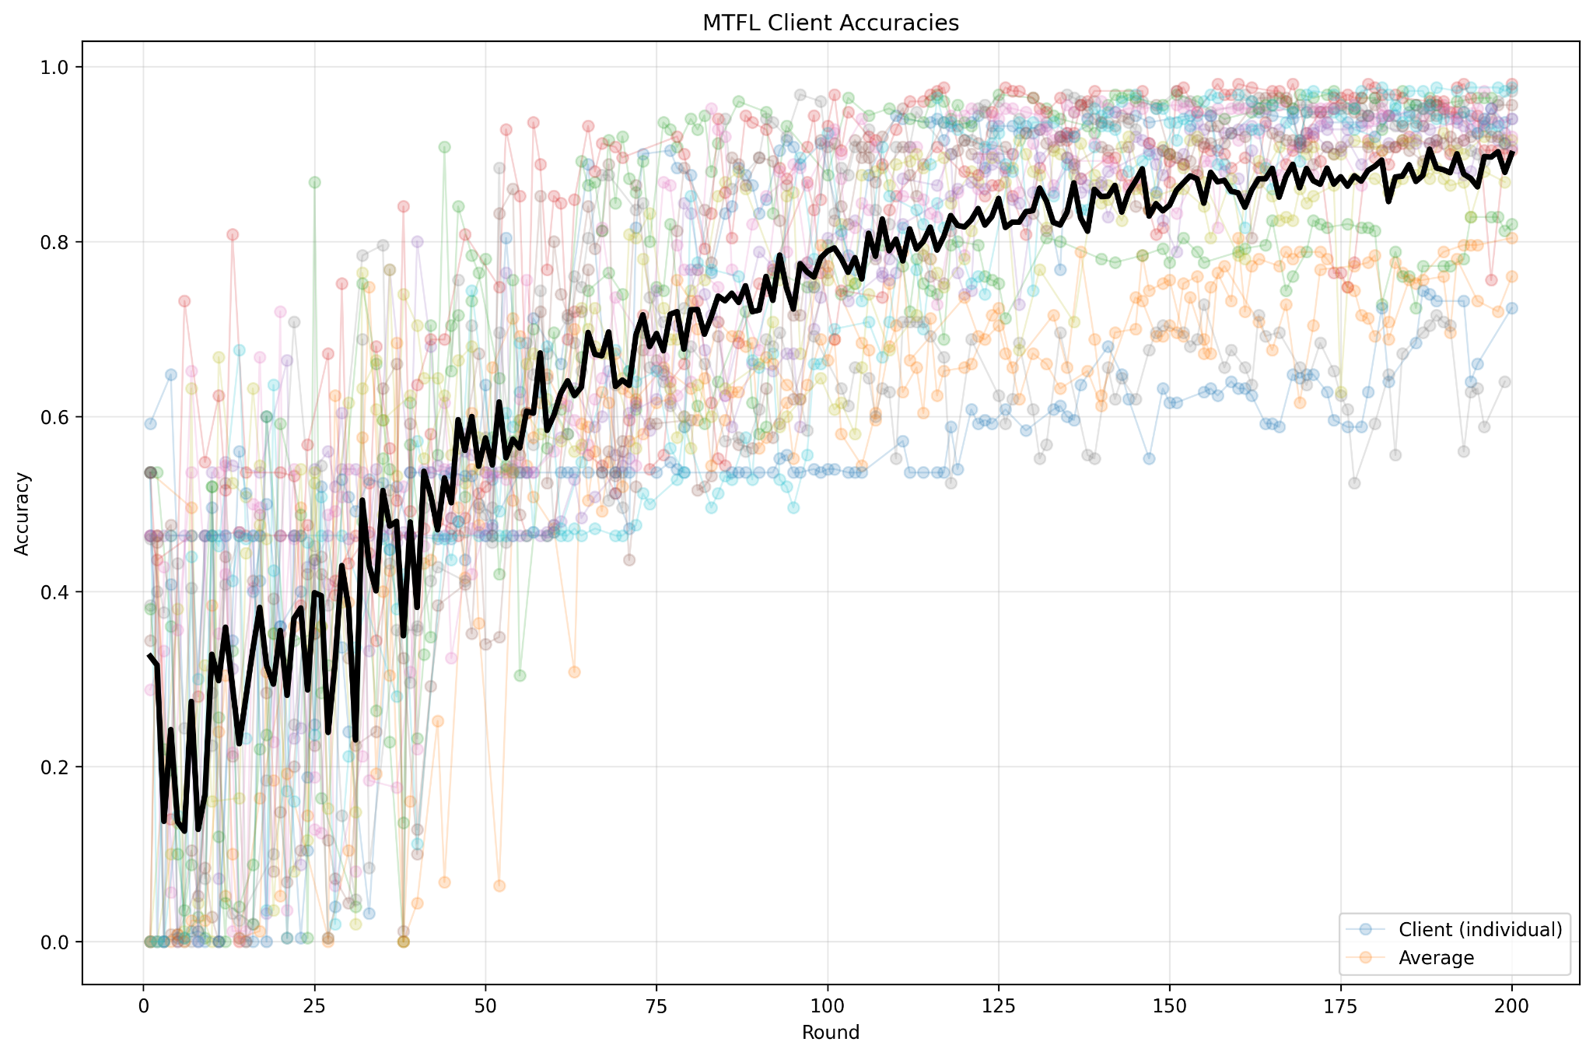
Variation in the per-round testing User Accuracy in the MTFL-FedAvg approach
MTFL achieves significantly better final accuracy
MTFL converges faster and more smoothly
MTFL reduces inter-client variance, better consistency and stability in MTFL
MTFL loss graph shows sharp, smooth decrease down to ~0.4
Personalized optimization and private BN clearly handle client heterogeneity

Slide 21
Thank You
Team -6 :
Deepti Sinha, Madhura Kadaba, Prajna k, Sarthak Sharma, Subin Pillai

